Slide 1


Investigation of porosity and morphology of Thin films by analyzing SEM images
Mr. I.M.G. Janindu Eranga B.Sc. (Perad.) | Mr. W.M.I.U.Rathnayake B.Sc. (Perad.) | Prof. T.M.W.J. Bandara B.Sc. (Ruhuna), M.Phil. (Perad.), Ph.D.(Perad.)
Faculty of Science
University of Peradeniya
Mr. I.M.G. Janindu Eranga
B.Sc. (Perad.)
Prof. T.M.W.J. Bandara
B.Sc. (Ruhuna), M.Phil. (Perad.),
Ph.D.(Perad.)

Slide 2
Introduction

Slide 3
Objective

Slide 4
Procedure
Sample Preparation
Scanning Electron Microscopy was conducted to capture high-resolution images of the thin film surfaces.
SEM images were processed to generate 3D depth surfaces using specialized software.

Slide 5
SEM Imaging

Slide 6
SEM Imaging

Slide 7
SEM Imaging

Slide 8
SEM Imaging

Slide 9
SEM Imaging

Slide 10
Analysis
Used Python libraries like NumPy, Matplotlib to load and process SEM images.
The intensity of darkness observed in scanning electron microscopy (SEM) images serves as a qualitative indicator of depth.
https://github.com/IsiraUdaththa/3D-representation-of-a-SEM-images

Slide 11
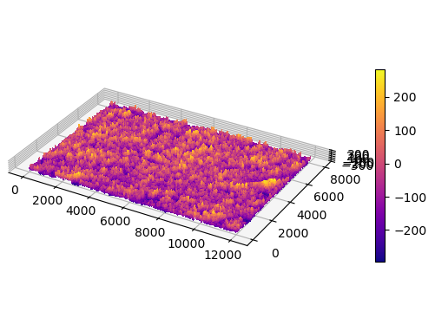
3D Depth Surfaces

Slide 12
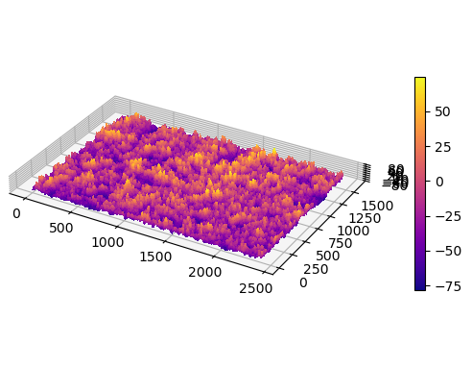
3D Depth Surfaces

Slide 13
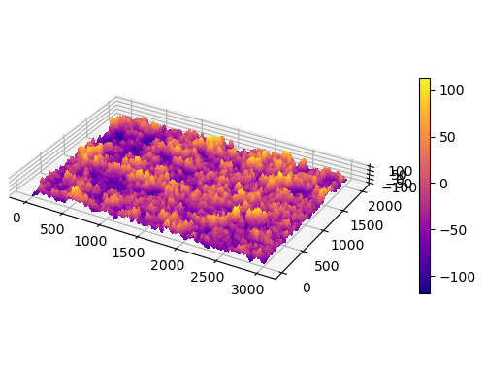
3D Depth Surfaces

Slide 14
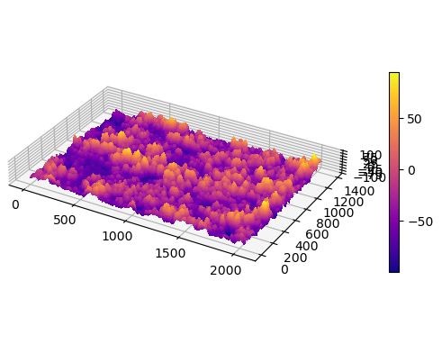
3D Depth Surfaces

Slide 15
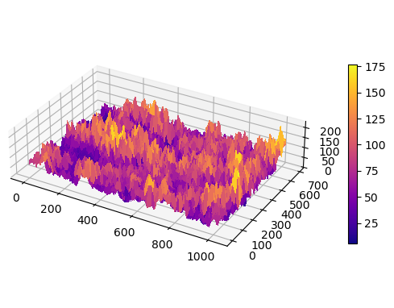
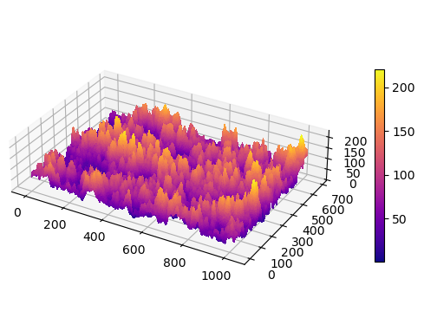
3D Depth Surfaces
The visualization varies depending on our depth estimation.
Currently, there is no algorithm available to determine it.

Slide 16
Acknowledgments
Thank any collaborators, advisors, or funding sources.

Slide 17
Q&A

Slide 18
Thank You!

